Slide 1
LIVER ,PANREASE, SPLEEN
BY.
DR.YASMEEN JASIM

Slide 2
-

Slide 3
Blood supply disorders
Liver infarction: is a type of hepatic necrosis caused by the obstruction of blood vessels ,which is rare due to the hepatic dual blood supply .
Causes include thrombosis , ligation or occlusion of main hepatic artery between the origin of the right gastric artery and hilum of the liver.
Microscopic features include: demarcated pale area .
Abscess formation fallowing infection.
Liquefaction.
Calcification
Bile accumulation.
Fibrosis /scarring

Slide 9
jaundice
jaundice : refers to a build up of yellow pigment in the blood and tissue, which causes a yellow discoloration in the skin, gums, and eyes. This is also called icterus or yellow jaundice. It's fairly easy to spot in dogs,
The build up of bilirubin in the blood that causes this is toxic and affects the liver, kidney, and brain tissue.

Slide 10
Symptoms
Discolored urine
Increased thirst or urination
Vomiting
Diarrhea
Loss of appetite
Lethargy
Weakness
Paleness
Fever
Abdominal pain
Orange tint to feces
Weight loss
Bleeding

Slide 11
jaundice
There are a few conditions that might cause jaundice in dogs:
Autoimmune disease
Cancerous tumours
Heartworm
Cirrhosis or liver damage, often from toxins
Pancreatic inflammation, stones, cancer, or infection
Bile duct obstruction
Injury
Collection of blood in the body cavity

Slide 12
Types of jaundice

Slide 13
Cholestasis
Cholestasis is a liver disease. It occurs when the flow of bile from your liver is reduced or blocked. Bile is fluid produced by your liver that aids in the digestion of food, especially fats. When bile flow is altered, it can lead to a build up of bilirubin. Bilirubin is a pigment produced by your liver and excreted from your body via bile

Slide 14
There are two types of cholestasis: intrahepatic cholestasis and extrahepatic cholestasis. Intrahepatic cholestasis originates within the liver. It can be caused by:
disease
infection
drug use
genetic abnormalities
hormonal effects on bile flow
Pregnancy can also increase your risk for this condition.
Extrahepatic cholestasis is caused by a physical barrier to the bile ducts. Blockages from things like gallstones, cysts, and tumors restrict the flow of bile

Slide 29
Hepatocellular (Liver Cell) Adenoma Adenomas arising from hepatocytes are rare and are reported in women in reproductive age group in association with use of oral contraceptives, sex hormone therapy and with pregnancy. The tumour presents as intrahepatic mass that may be mistaken for hepatocellular carcinoma and may rupture causing severe intraperitoneal haemorrhage.
Bile Duct Adenoma (Cholangioma) Intrahepatic or extrahepatic bile duct adenoma is a rare benign tumour. The tumour may be small, composed of acini lined by biliary epithelium and separated by variable amount of connective tissue, or are larger cystadenomas having loculi lined by biliary epithelium.

Slide 31
Haemangioma

Slide 34
Hepatocellular Carcinoma Hepatocellular carcinoma (HCC) or liver cell carcinoma, also termed as hepatoma, is the most common primary malignant tumour of the liver.
Haemangioma is the commonest benign tumour of the liver. Majority of them are asymptomatic and discovered incidentally. Rarely, a haemangioma may rupture into the peritoneal cavity. .

Slide 35
Cholangiocarcinoma
Cholangiocarcinoma is the designation used for carcinoma arising from bile duct epithelium within the liver (peripheral cholangiocarcinoma). Carcinomas arising from the large hilar ducts (hilar cholangiocarcinoma) and from extrahepatic ducts are termed bile duct carcinomas .None of the etiologic factors related to HCC have any role in the genesis of cholangiocarcinoma.
However, the etiological factors involved in it are exposure to radio-opaque dye thorotrast, anabolic steroids,

Slide 36
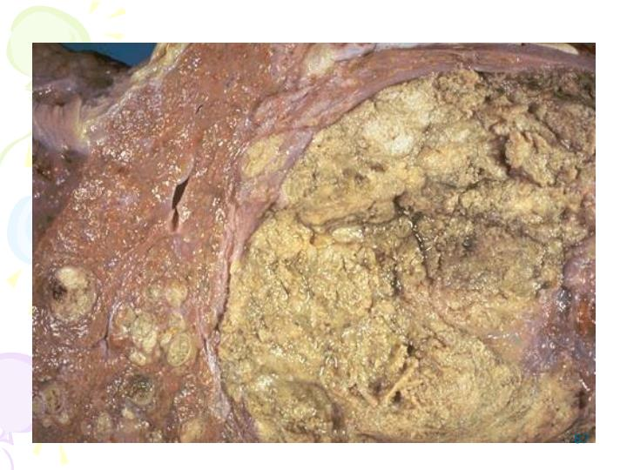

Slide 42
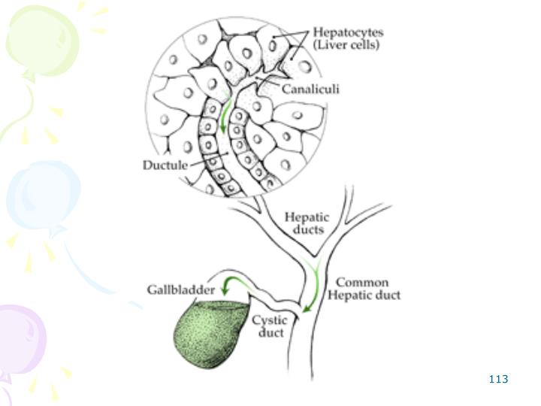

Slide 46
pancreas

Slide 48
Cystic Fibrosis
Cystic fibrosis of the pancreas or fibrocystic disease is a
hereditary disorder characterised by viscid mucous
secretions in all the exocrine glands of the body (mucoviscidosis) and associated with increased concentrations of electrolytes in the eccrine glands. The terms ‘cystic fibrosis’ and ‘fibrocystic disease’ are preferable over ‘mucoviscidosis’ in view of the main pathologic change of fibrosis produced as a result of obstruction of the passages by viscid mucous secretions

Slide 49
MORPHOLOGIC FEATURES. Depending upon the severity of involvement and the organs affected, the pathologic changes are variable. Most of the changes are produced as a result of obstruction by viscid mucous.
Grossly, pancreatic lobules are ovoid. Fatty replacement of the pancreas and grossly visible cysts may be seen.
Microscopically,
the lobular architecture of pancreatic parenchyma is maintained. There is increased interlobularfibrosis. The acini are atrophic and many of the acinar
ducts contain laminated, eosinophilic concretions. Rarely,inflammation, fat necrosis and cyst formation may be seen.
The islet tissue (endocrine pancreas) generally remains intact. Atrophy of the exocrine pancreas may cause impaired fat absorption.

Slide 50
PANCREATITIS
PANCREATITIS
Pancreatitis is inflammation of the pancreas with acinic cell
injury. It is classified into acute and chronic forms both of
which are distinct entities.
Acute pancreatitis is an acute inflammation of the pancreas
presenting clinically with ‘acute abdomen’. The severe form
of the disease associated with macroscopic haemorrhages
and fat necrosis in and around the pancreas is termed acute
haemorrhagic pancreatitis or acute pancreatic necrosis.

Slide 51
The onset of acute pancreatitis is sudden, occurring after
a bout of alcohol or a heavy meal. The patient presents with
abdominal pain, vomiting and collapse and the condition
must be differentiated from other diseases producing acute
abdomen such as acute appendicitis,

Slide 52
ETIOLOGY.
The two leading causes associated with acute pancreatitis are alcoholism and cholelithiasis, both of which are implicated in more than 80% of cases. Less common causes of acute pancreatitis include trauma, ischaemia, shock, extension of inflammation from the adjacent tissues, blood borne bacterial infection, viral infections.

Slide 53
MORPHOLOGIC FEATURES.
Grossly, in the early stage, the pancreas is swollen and oedematous. Subsequently,in a day or two, characteristic variegated appearance o grey-white pancreatic necrosis, chalky-white fat necrosis and blue-black haemorrhages are seen. In typical case, theperitoneal cavity contains blood-stained ascitic fluid and white flecks of fat necrosis in the omentum, mesentery and peripancreatic tissue. The resolved lesions show areas of fibrosis, calcification and ductal dilatation.
Microscopically,
1. Necrosis of pancreatic lobules and ducts.
2. Necrosis of the arteries and arterioles with areas of
haemorrhages.
3. Fat necrosis.
4. Inflammatory reaction, chiefly by polymorphs, around
the areas of necrosis and haemorrhages.

Slide 54
Carcinoma of Pancreas
Pancreatic cancer is the term used for cancer of the exocrine
pancreas. It is one of the common cancers of the pancreas is the second most common cancer of the alimentary tract.
MORPHOLOGIC FEATURES. The most common location of pancreatic cancer is the head of pancreas (70%),
followed in decreasing frequency, by the body and the
tail of pancreas
Grossly, carcinoma of the head of pancreas is generally small, homogeneous, poorly-defined, grey-white mass without any sharp demarcation between the tumour and the surrounding pancreatic parenchyma.
Microscopically, most pancreatic carcinomas arise from
the ductal epithelium

Slide 55
+

Slide 56
spleen
splenomegaly. Splenomegaly is a condition that occurs when your spleen becomes enlarged. It’s also commonly referred to as enlarged spleen or spleen enlargement.

Slide 57
What can cause splenomegaly?
A number of diseases and conditions can cause an enlarged spleen. Infections, such as mononucleosis, are among the most common causes of splenomegaly. Problems with your liver, such as cirrhosisand cystic fibrosis, can also cause an enlarged spleen.
Another possible cause of splenomegaly is juvenile rheumatoid arthritis. This condition can cause inflammation of the lymph system. Because the spleen is part of the lymph system, this inflammation can result in the spleen becoming enlarged.
Other potential causes of an enlarged spleen include:
malaria
Hodgkin’s disease
leukemia
heart failure
cirrhosis
tumors in the spleen or from other organs that have spread to the spleen
viral, bacterial, or parasitic infections
inflammatory diseases, such as lupus or rheumatoid arthritis

Slide 58
splenitis, enlargement and inflammation of the spleen as a result of infection, parasite infestation, or cysts.
Infections spread readily to the spleen from other parts of the body. In pneumonia the spleen is moderately enlarged and soft; the cut surface is reddish to gray, while the tissue may be mushy in consistency. In typhoid the enlargement is greater because of the large amount of blood congestion. In infectious mononucleosis, so called because of the presence of abnormal numbers of white blood cells of the type called mononuclear leukocytes, swelling three to four times the normal size occurs. There are large clumps of white blood cells in the sinuses and pulp.

